Slide 1
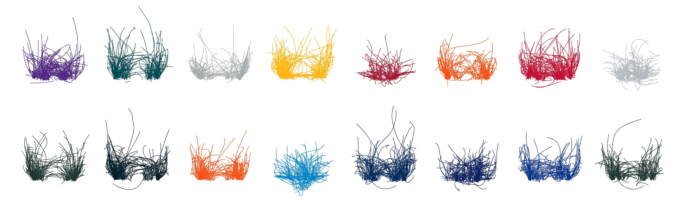
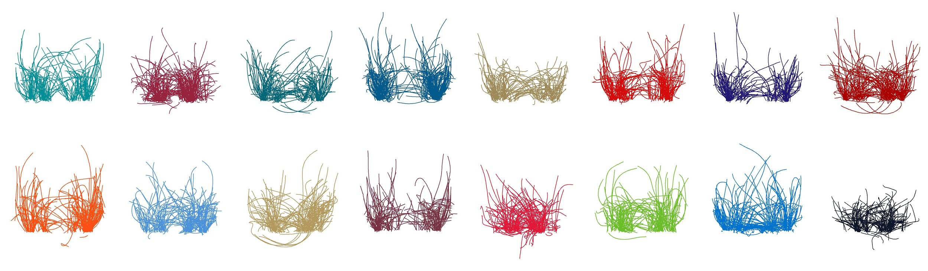
The Routes to Success
Dani Chu, Matthew Reyers, James Thomson, Lucas Wu

Slide 2



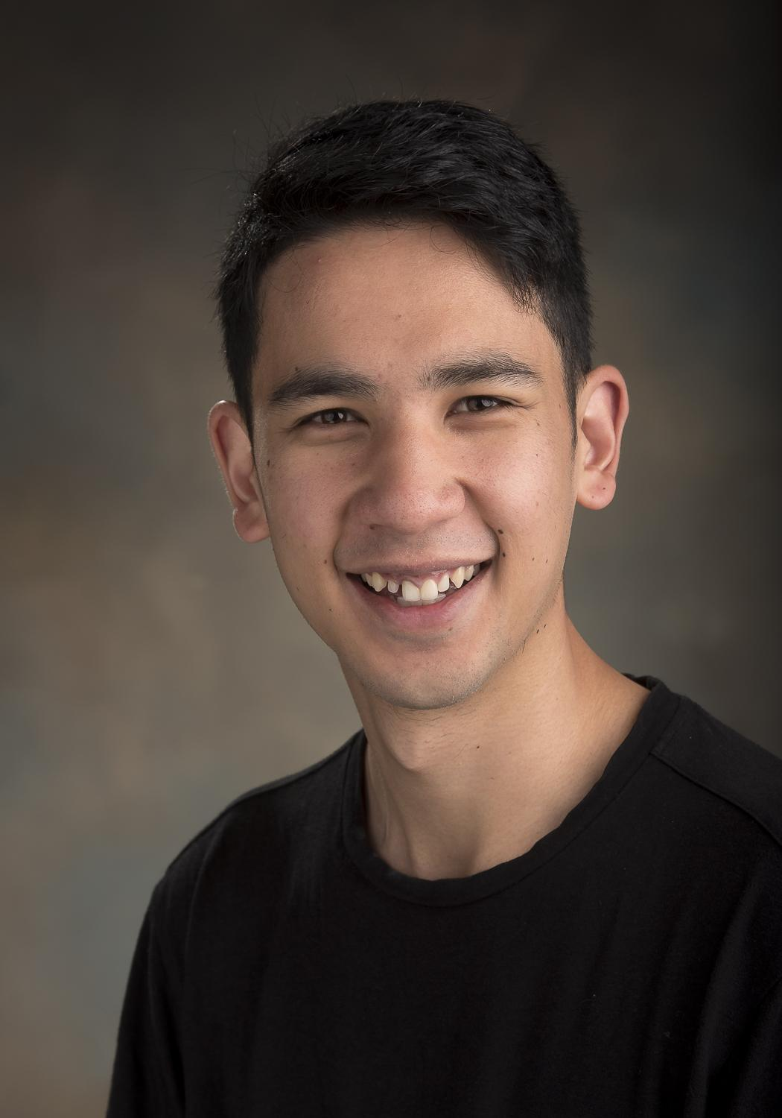
Our Team
Lucas Wu
PhD Student
Simon Fraser University
yifan_wu@sfu.ca
@lucaswu123
James Thomson
MSc Student
Simon Fraser University
james_thomson_2@sfu.ca
Matthew Reyers
MSc Student
Simon Fraser University
matthew_reyers@sfu.ca
Dani Chu
MSc Student
Simon Fraser University
dani_chu@sfu.ca
@chuurveg
Notes:
Matt: Also say Thanks to M. Lopez, NextGenStats, NFL, and Stats department, Simon Fraser University

Slide 3
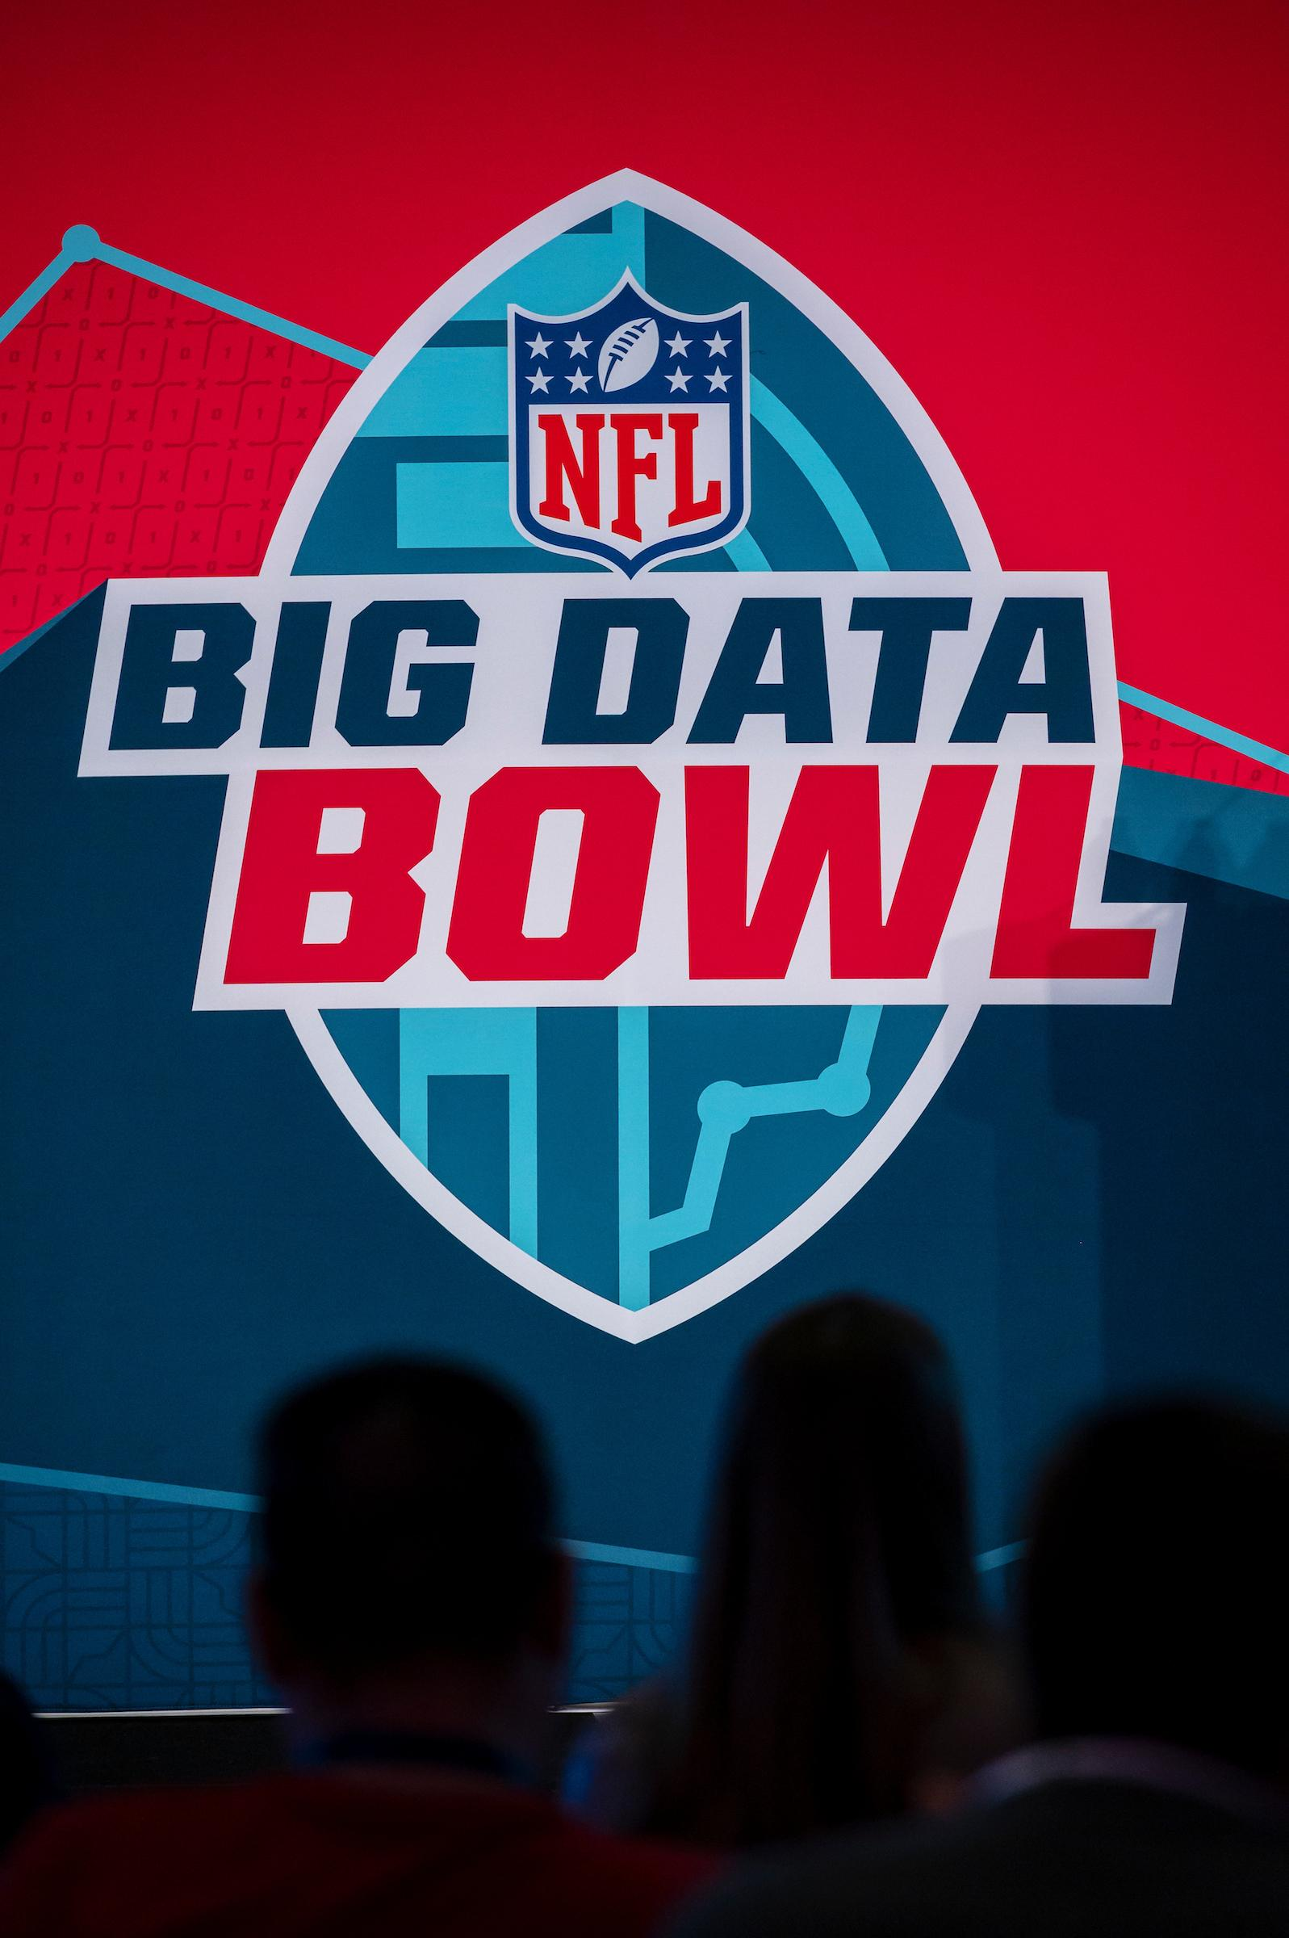

The NFL Big Data Bowl
Inaugural Event designed to:
Involve Next Gen Stats
Generate new ideas
Demonstrate analyst talent
Notes:
We had a 9 day timeframe to accomplish thi

Slide 4




The Participants
1000 applicants
125 submissions
Split between College and Open Divisions
4 Finalists from each division
Notes:
We had a 9 day timeframe to accomplish thi

Slide 5
The Timeline
Report: December 18th to January 22nd
We started on January 11th
Finalists Notified: February 4th
Finalist Presentations: February 27th
Notes:
We had a 9 day timeframe to accomplish thi

Slide 6
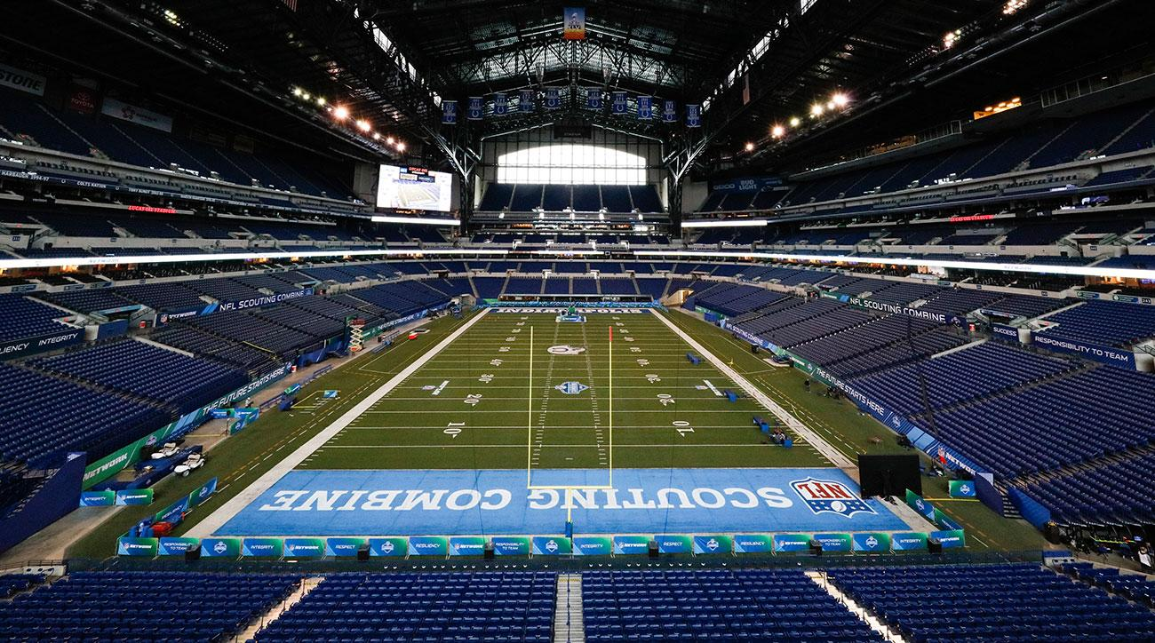
The Finalist Presentations
Indianapolis, NFL Combine
5 minute presentation
60 minute poster chat
Notes:
We had a 9 day timeframe to accomplish thi

Slide 7
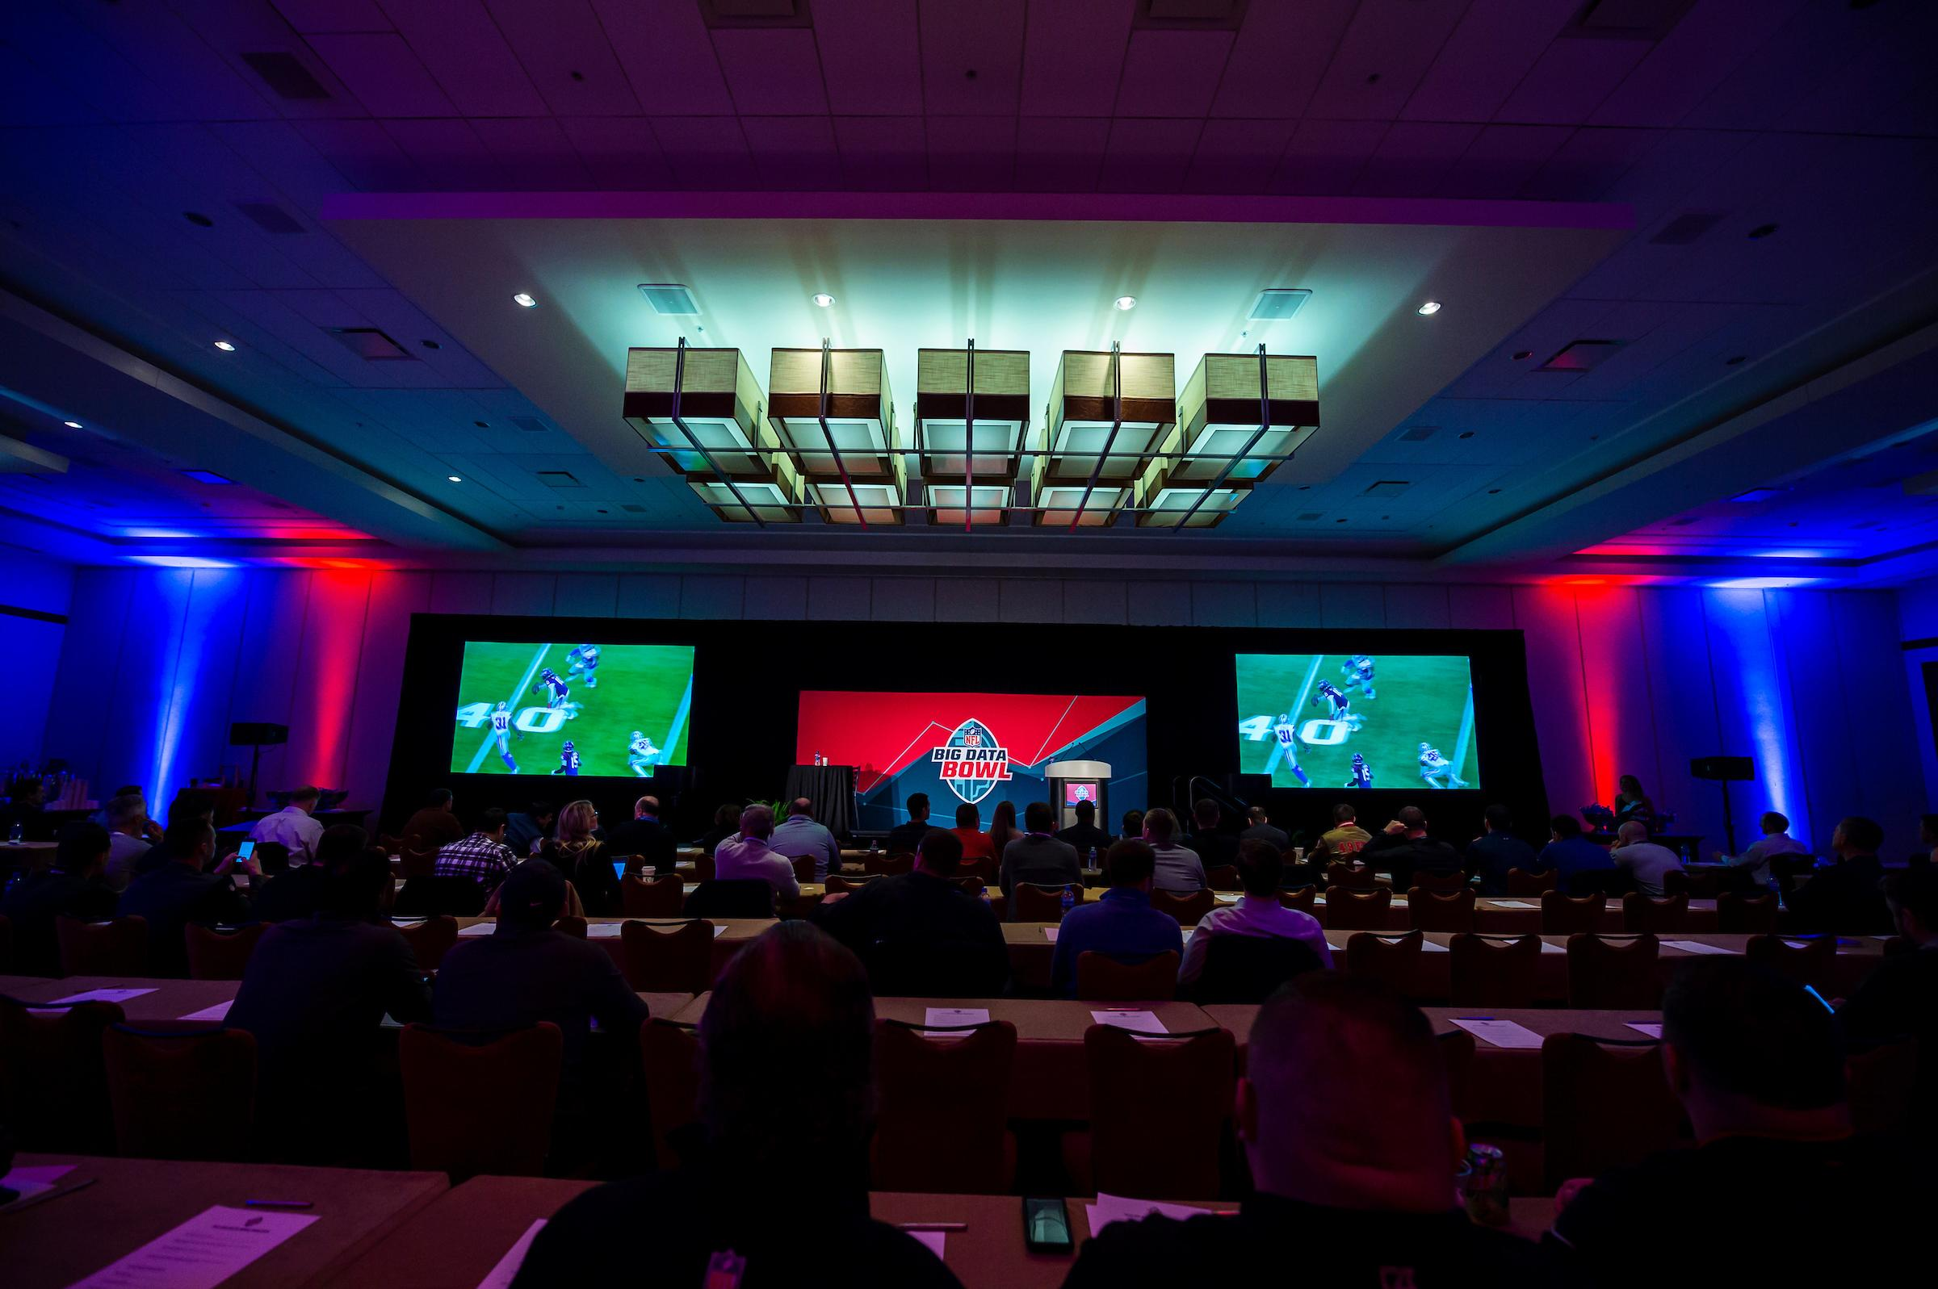
Notes:
We had a 9 day timeframe to accomplish thi

Slide 8
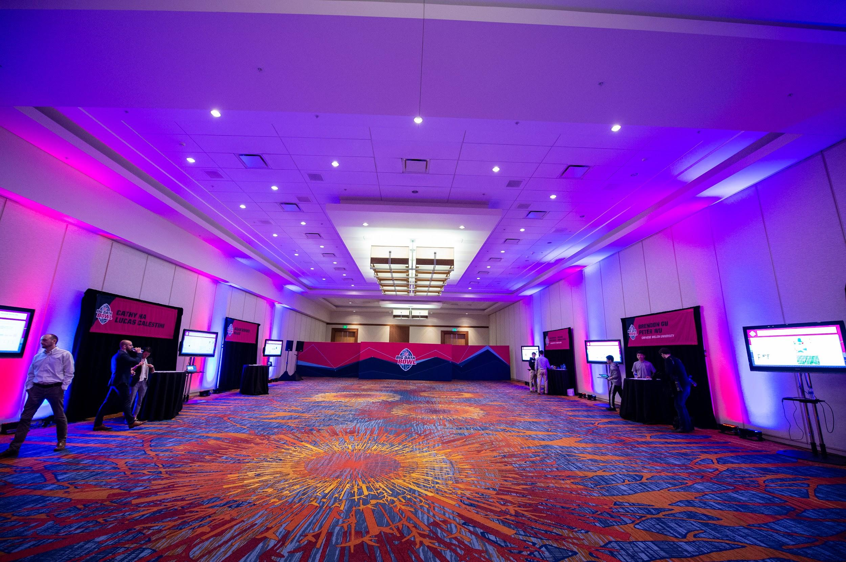
Notes:
We had a 9 day timeframe to accomplish thi

Slide 9
The Data
NFL player tracking data from the first 6 weeks of the 2017 regular season
10 frames per second
(x, y) location of each player and the ball
7,000 passing plays, 34,000 routes
Notes:
We had a 9 day timeframe to accomplish thi

Slide 10
The Challenge
Choice between 3 Themes
Understanding Speed
Propose a Rule Change
Identify Best Receiver-Route Combinations
Notes:
We had a 9 day timeframe to accomplish thi

Slide 11
Our Goals
Player route profiles
Monitor player tendencies, usage and effectiveness
Play evaluation metrics
Evaluate the play book
Play database
Identify plays of interest
Pull film quickly
Save 1000s of hours tagging film
Notes:
Matt

Slide 12
Identifying Routes

Slide 13
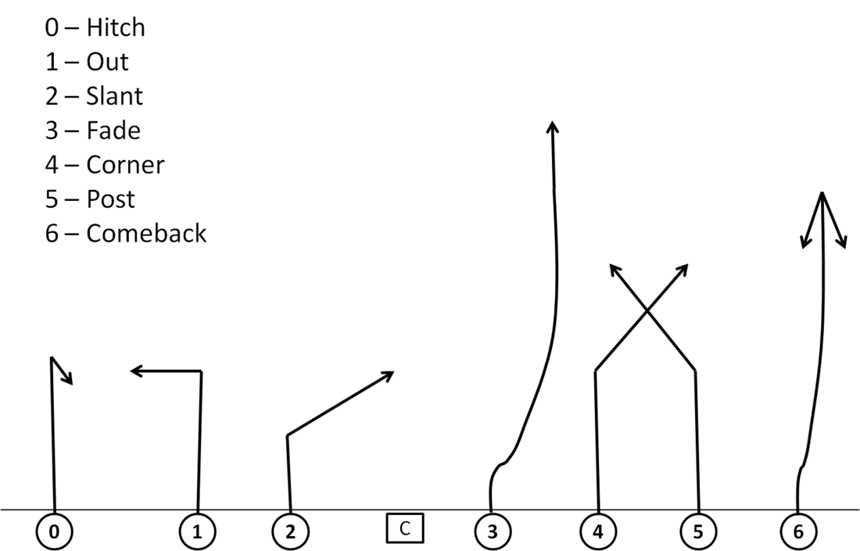
What is a Route?

Slide 14
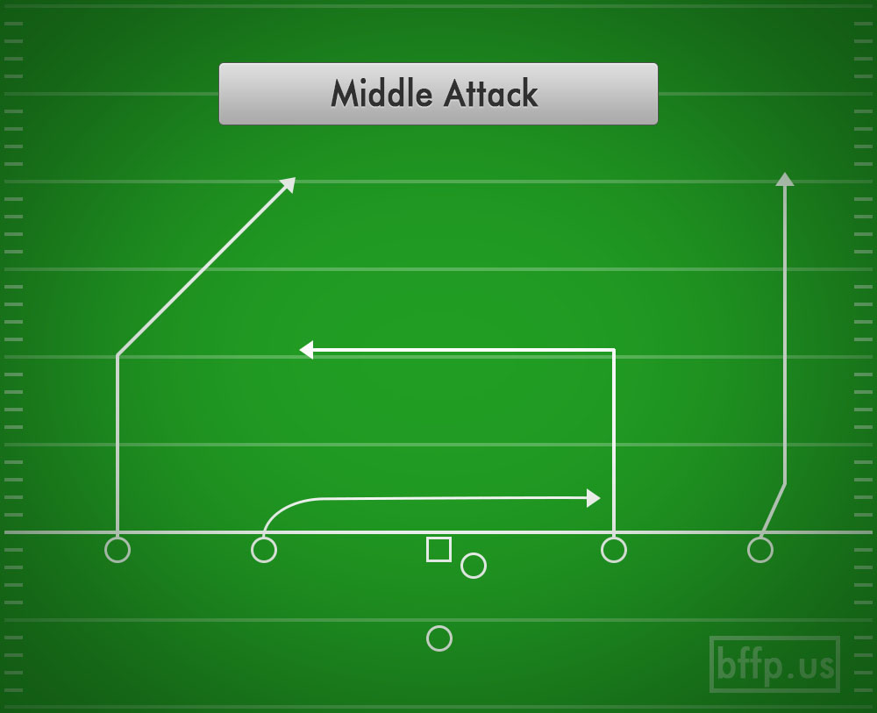
What is Play Design

Slide 15
How Did We Identify Routes?
For all routes
Standardize to same starting point and direction
Fit Bezier curves
Observations are control points, smooths routes
Notes:
Routes > 2 seconds

Slide 16
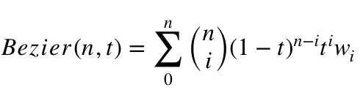
Bezier Curves
We fit bezier curves to the position data using
Where t is defined from [0,1], the bezier interval
n is the number of control points (knots) we use to define the shape of the curve
Weights w are the coordinate values which we fit to the curve

Slide 17
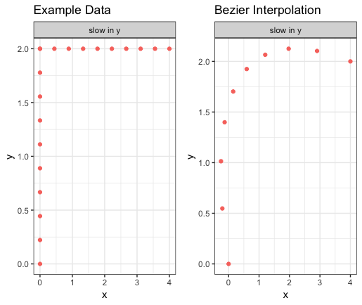
3 Control Points

Slide 18
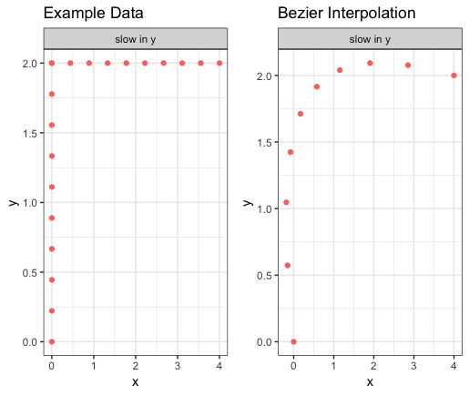
4 Control Points

Slide 19
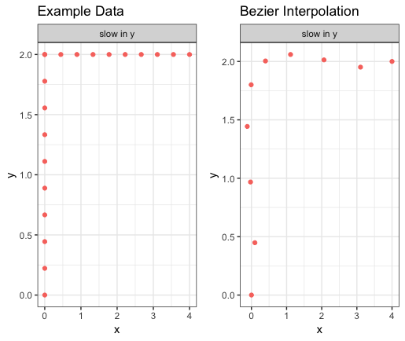
5 Control Points

Slide 20
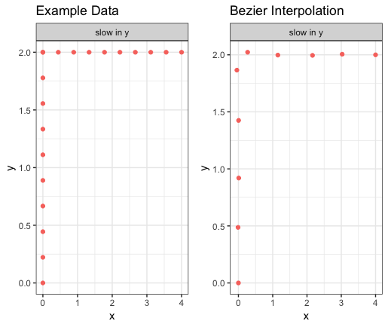
10 Control Points

Slide 21
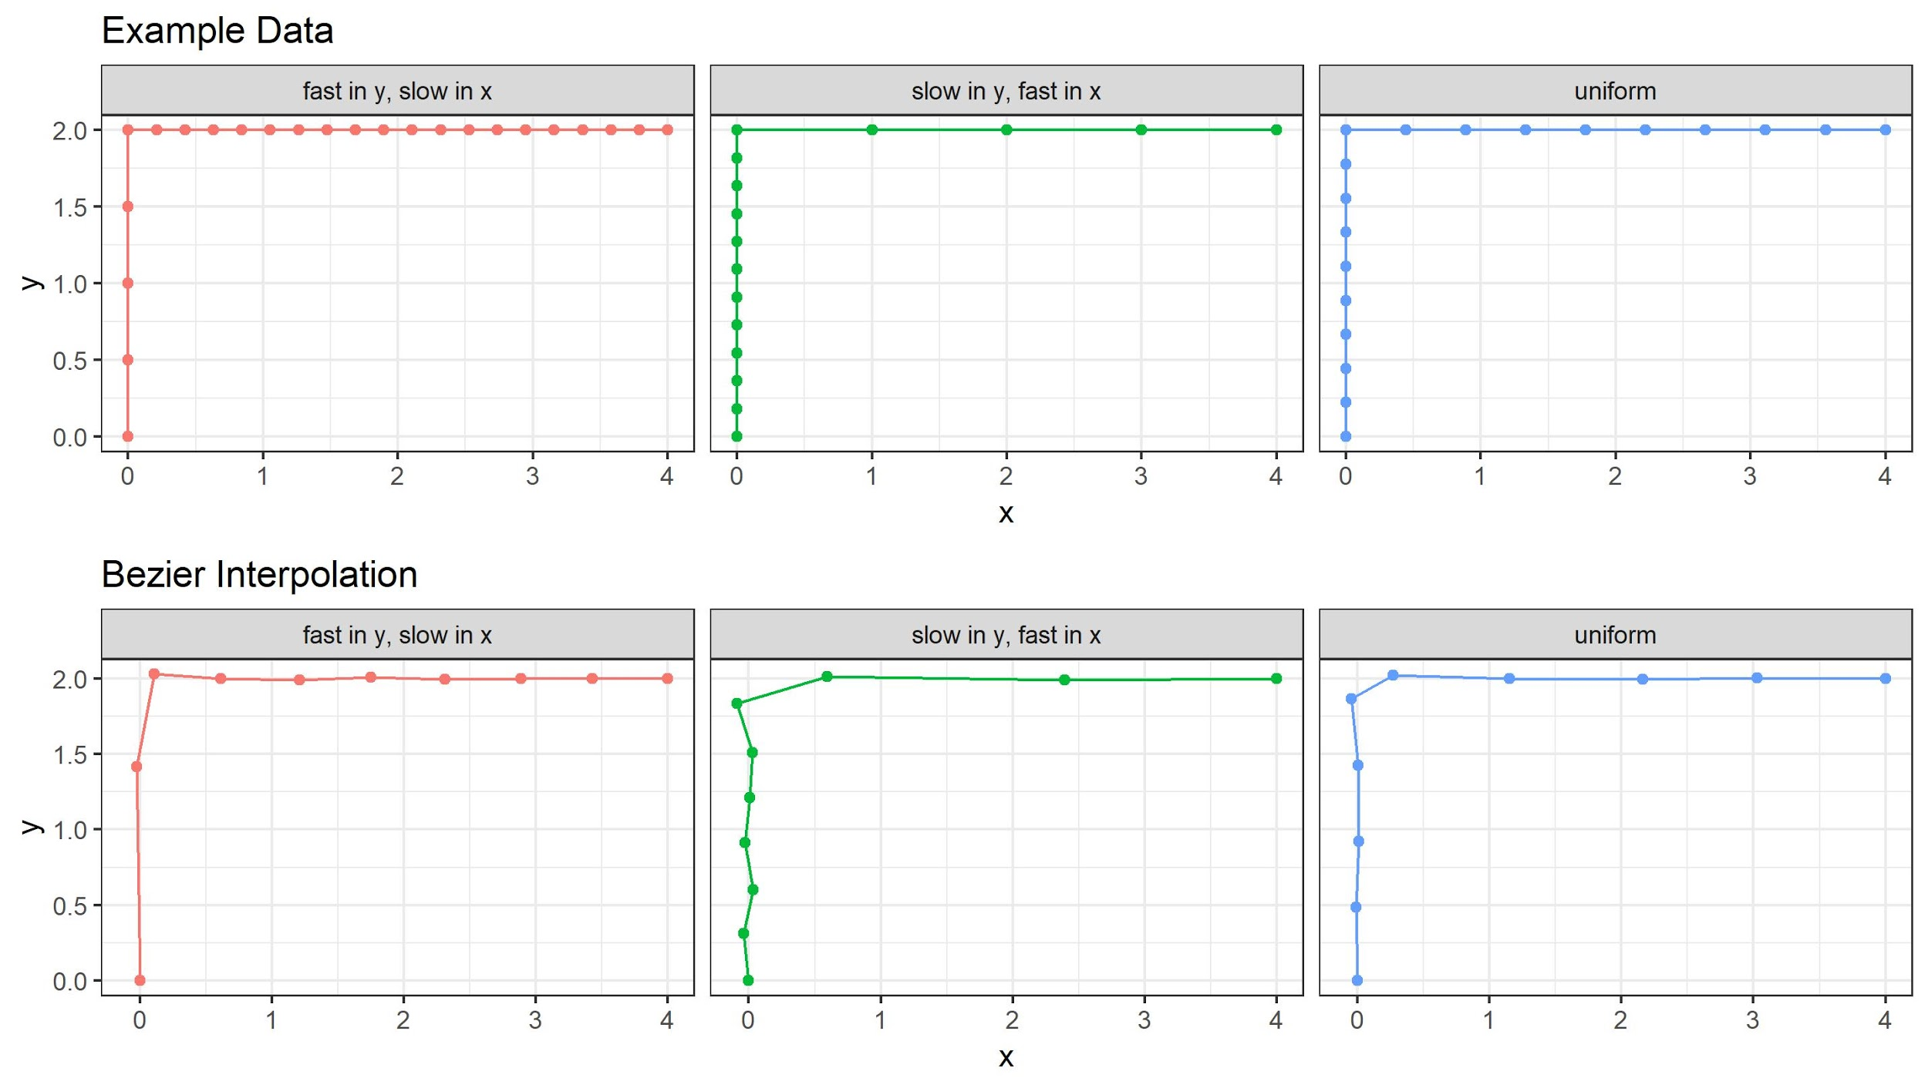
Comparing Routes Of Different Speeds

Slide 22
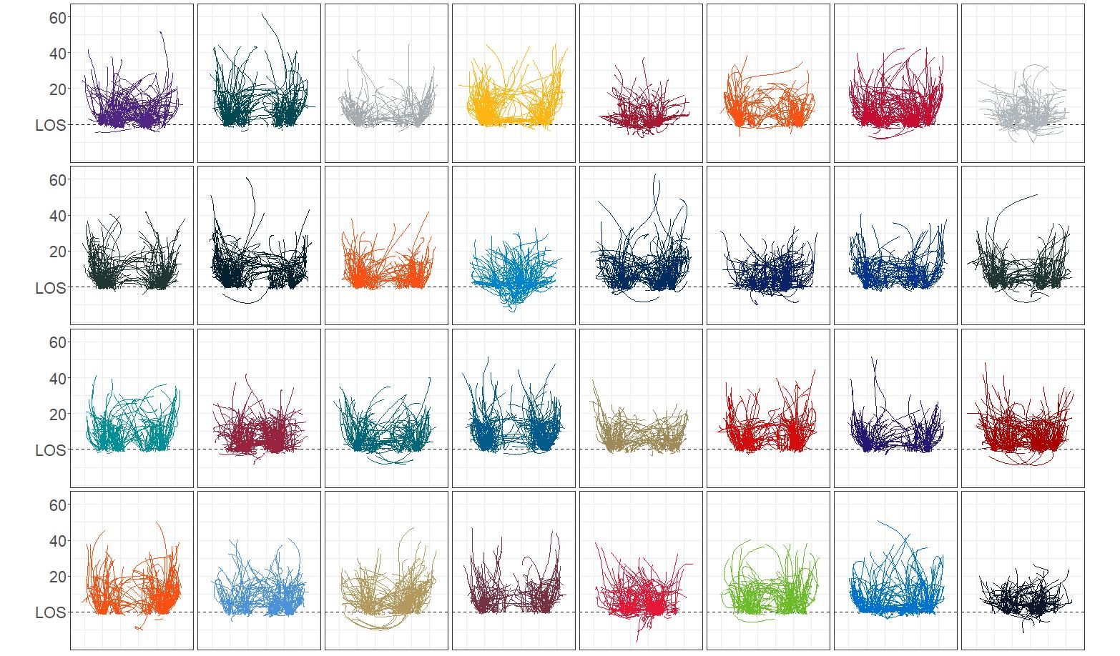
Functional Clustering
Notes:
For the receiver on each team with the most routes run this is a visualization of their routes being clustered by shape, and classified.

Slide 23
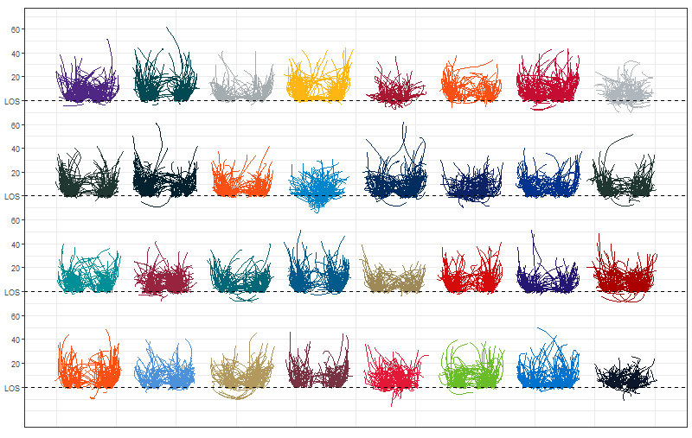
Functional Clustering
Notes:
For the receiver on each team with the most routes run this is a visualization of their routes being clustered by shape, and classified.

Slide 24
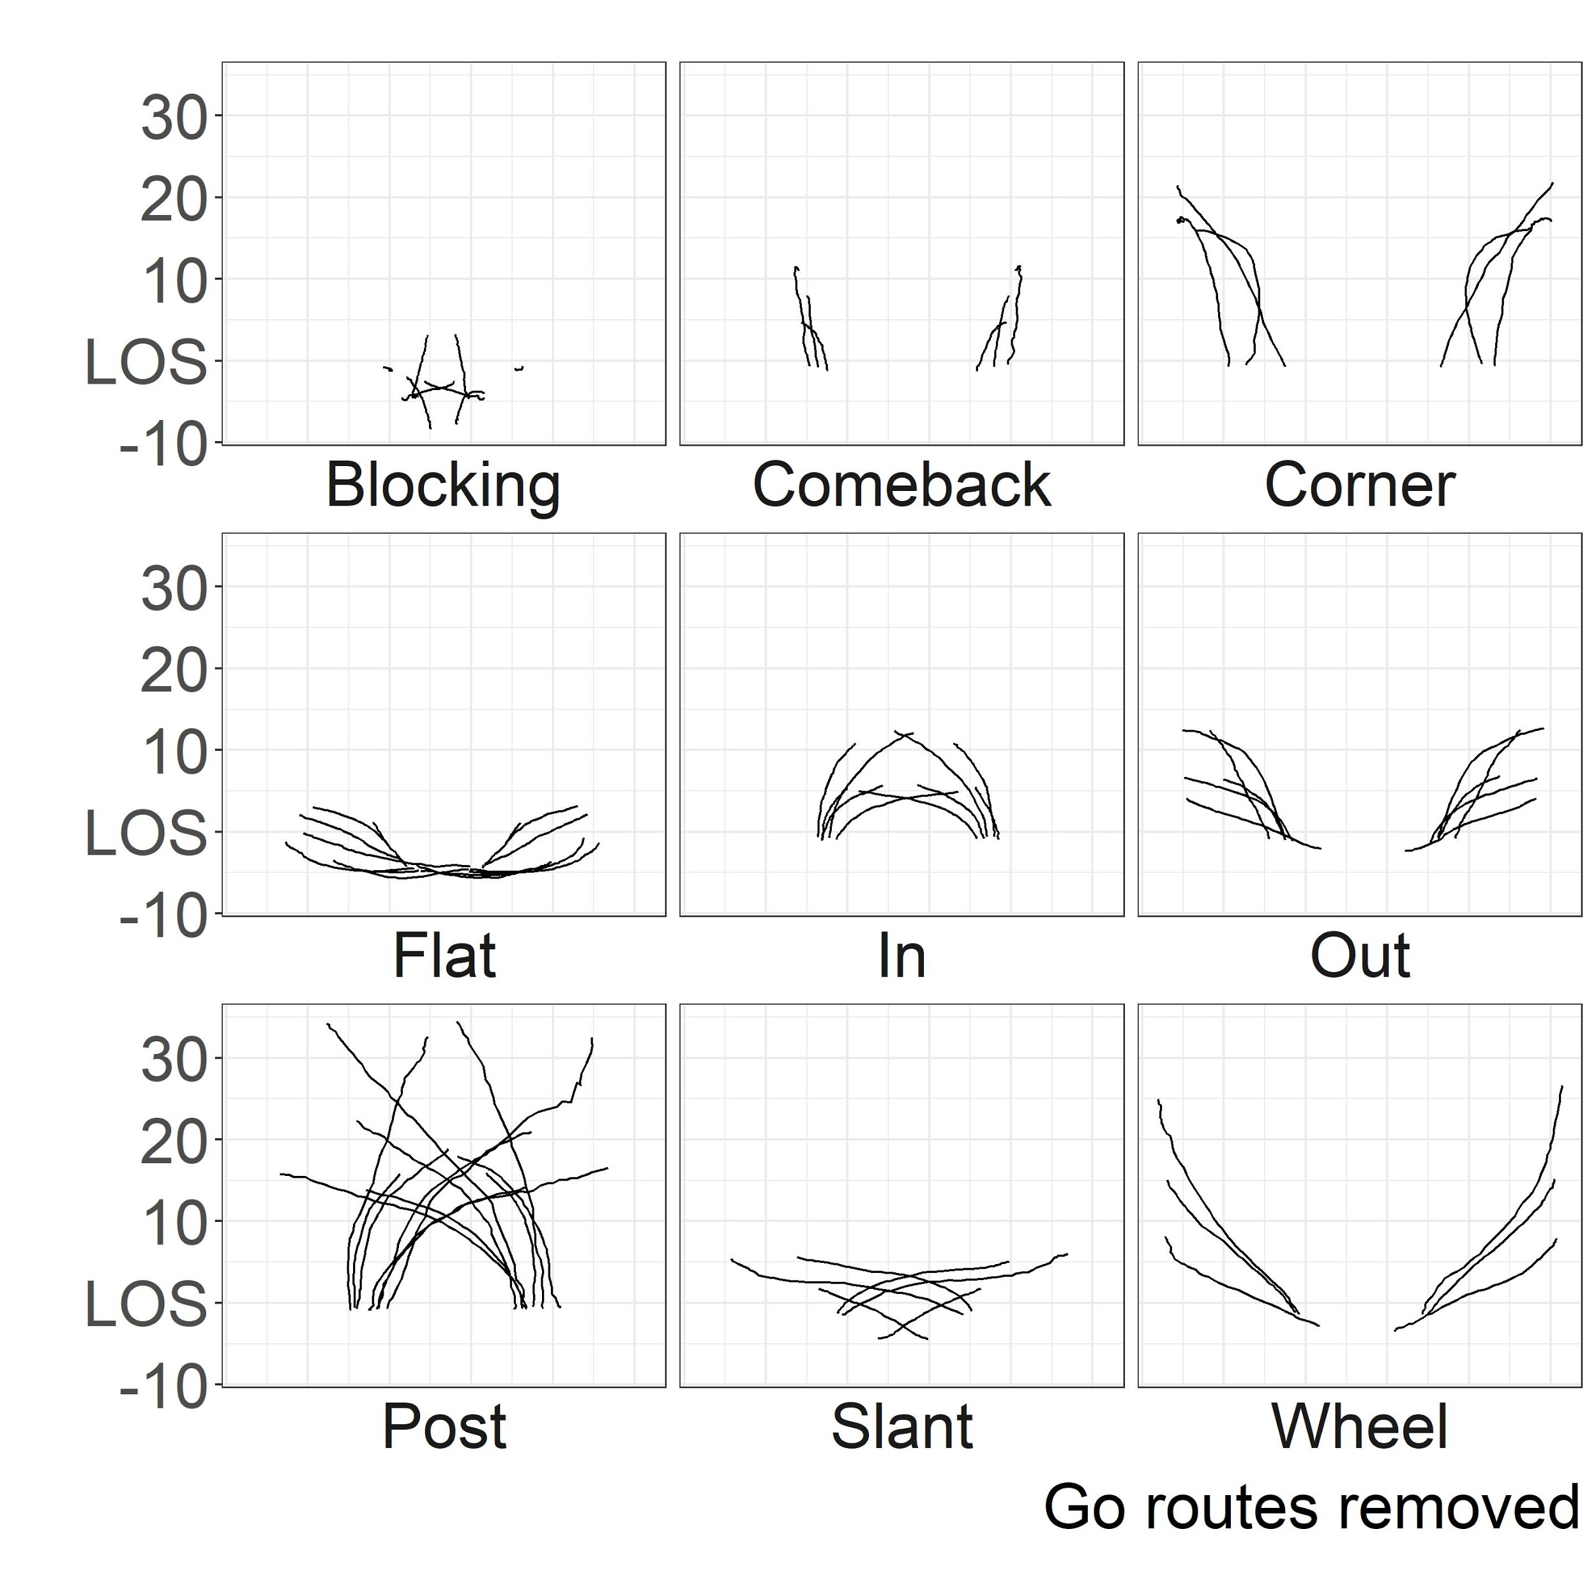
Route Labelling
Notes:
For the receiver on each team with the most routes run this is a visualization of their routes being clustered by shape, and classified.

Slide 25
Route Profiles

Slide 26
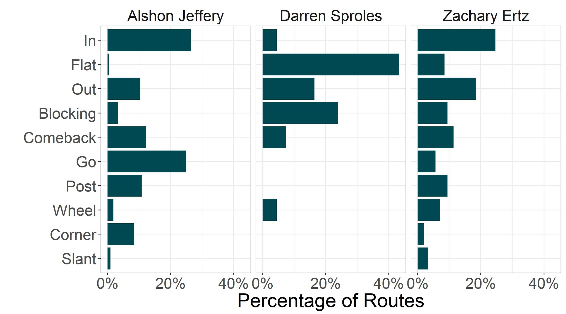
Position Comparisons
Notes:
BIG LEGENDS
Why are there two receivers from the same team?
Highlights different player usage, even within the same team for players that do the role differently

Slide 27
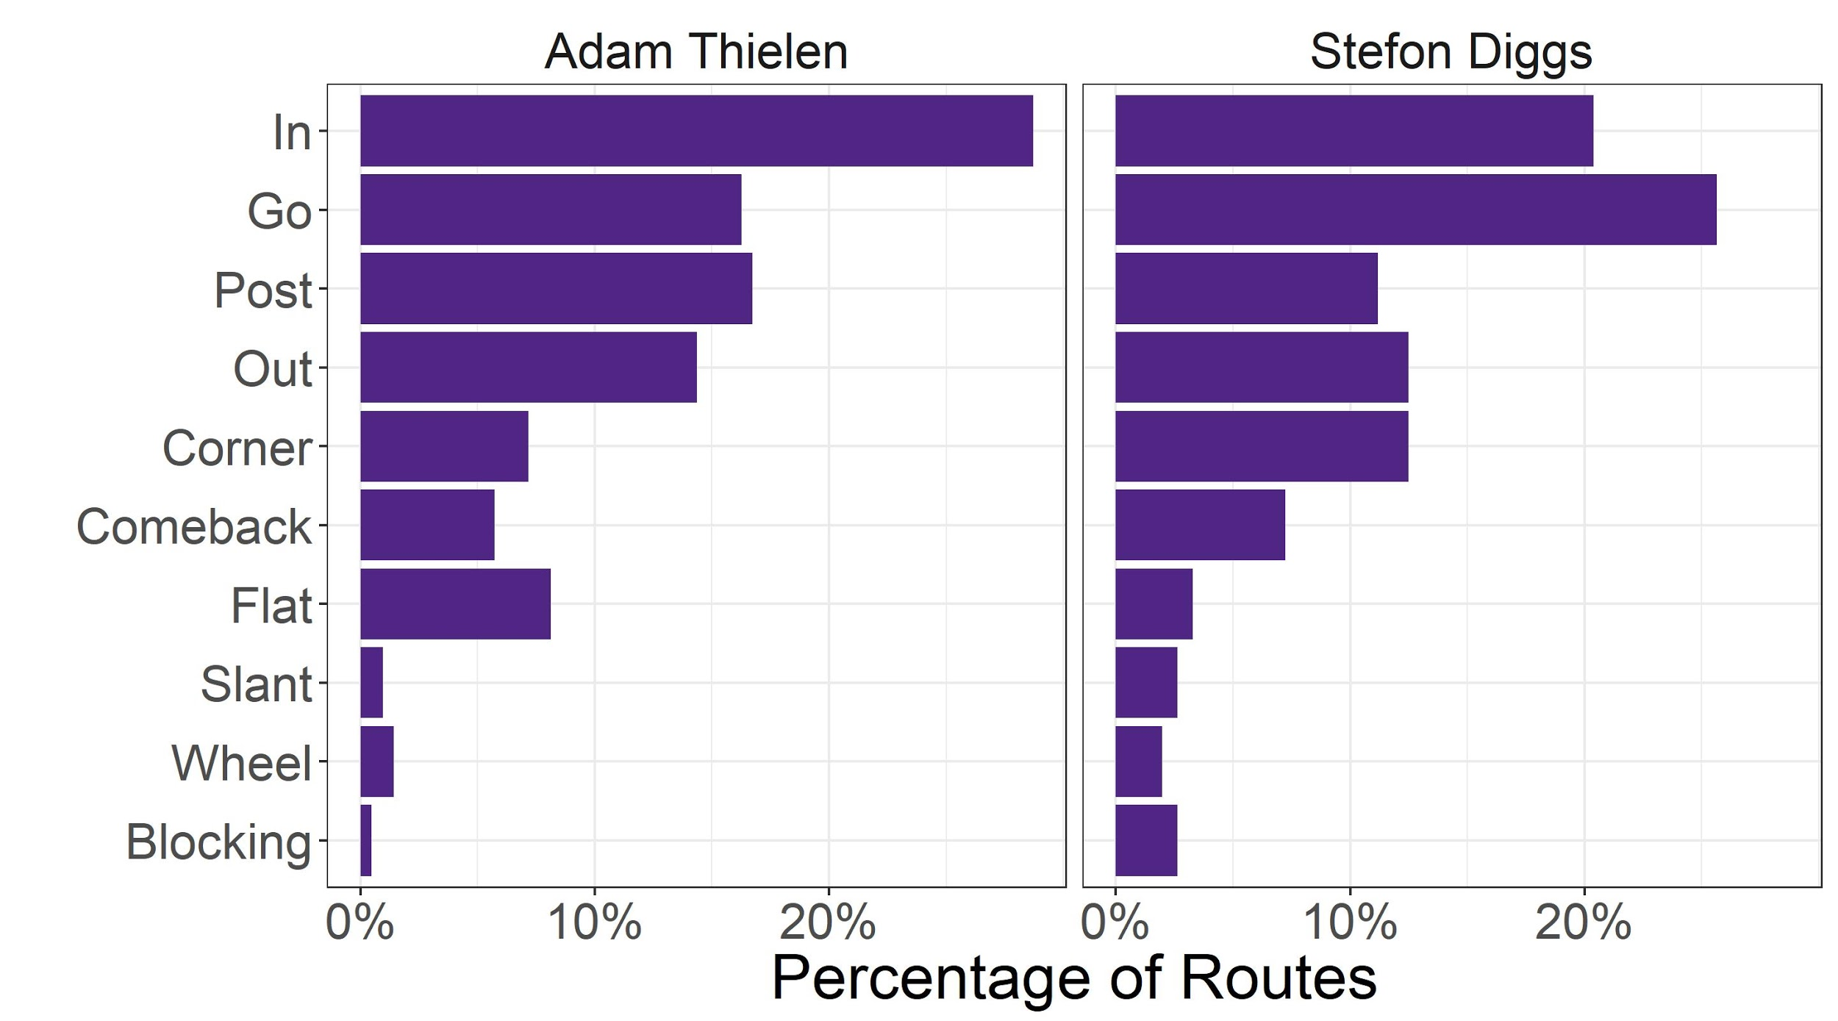
Player Comparisons
Notes:
BIG LEGENDS
Why are there two receivers from the same team?
Highlights different player usage, even within the same team for players that do the role differently

Slide 28
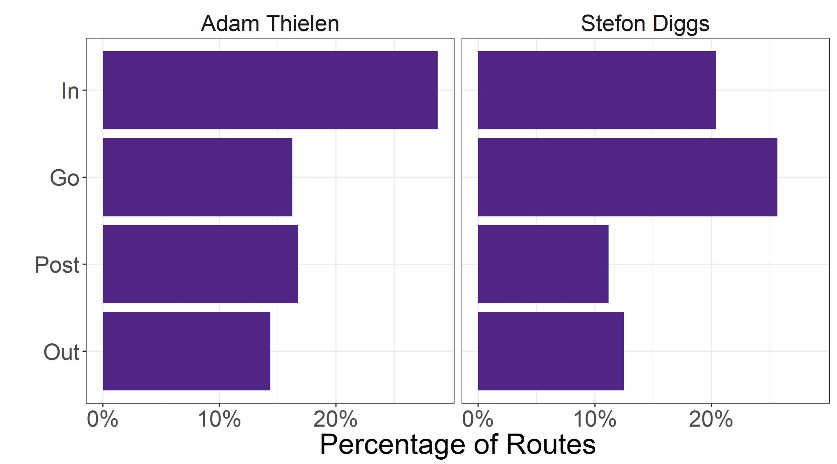
Player Comparisons
Notes:
BIG LEGENDS
Why are we just using 4 routes?
These routes had the largest sample size and have the more realistic estimates
These players have similar route composition, why are we comparing them?
Because each player has different strengths for each type of route (next slides)

Slide 29
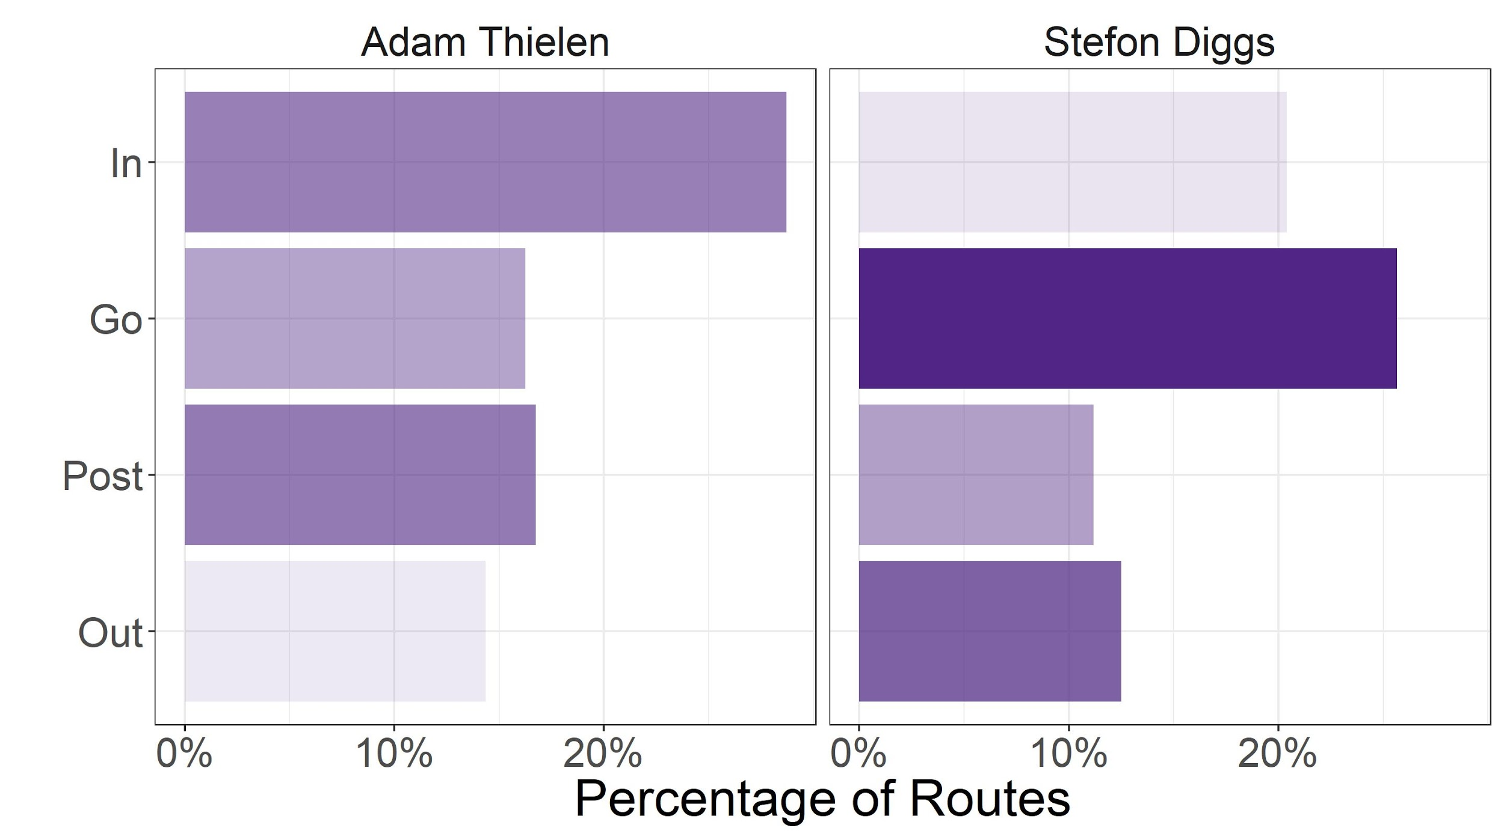
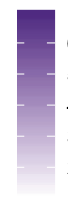
Which Routes Lead to Big Plays?
High
Low
Notes:
BIG LEGENDS
What does the darkness of the colour mean?
Darker colour is connected to bigger plays on average

Slide 30
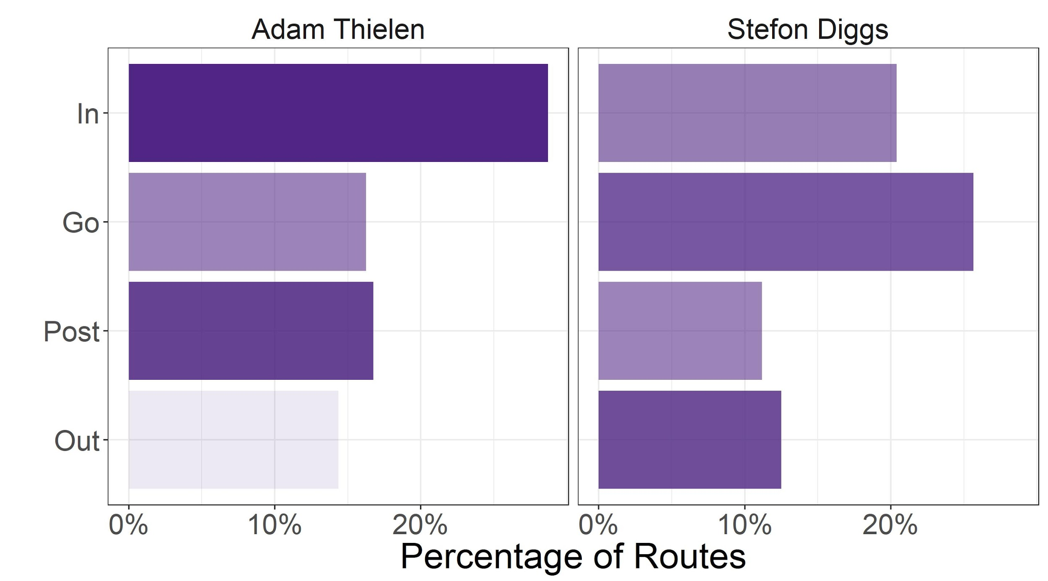
Which Routes Lead to Consistent Success?
High
Low
Notes:
What does the colour mean?
Darker colour is related to more frequently completed and positive plays

Slide 31
Evaluating Route
Combinations

Slide 32
Result-based Evaluation of Route Combinations
Grouped duos of routes into 4 groups based on the results of the play
Consistent & Big Play Potential
Inconsistent & Big Play Potential
Consistent & Less Big Play Potential
Inconsistent & Less Big Play Potential
We found one of the best combination duos is the Out & Go
Notes:
What are the duos?
We can explain those to people at our booth, print them out and show people if they ask us

Slide 33
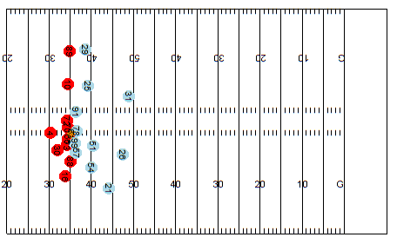
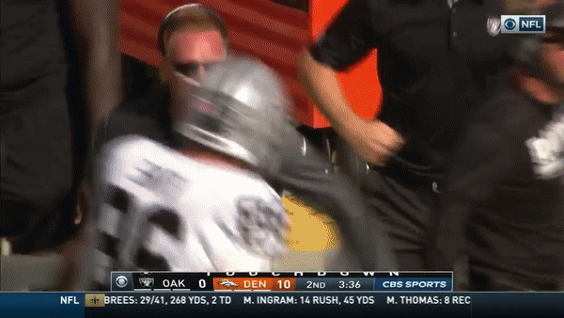
The Out and Go
Notes:
Try to trim GIF to same length as other
Why is Denver blue and Oakland red?
Defense gets blue, offense gets red
Yea before they were just darker version, I changed it for consistency with our future slides

Slide 34

Can we Quantify Openness?
Factors to consider:
Nearest defenders
Speed of receivers
Direction of receivers
Space created by teammates
Notes:
Matt:
Angle of arrow indicates the direction they’re running
Length of arrow indicates the magnitude of the speed
For the offence, openness can be used to identify good attacking opportunity
For the defence, interested in how to suppress the openness of the offence team

Slide 35
Calculating Openness
Calculating field control of a player at the time of release of a ball
compute team field control
Control is estimated at 1 second into the future from the time of the football being released
Notes:
From there we were able to

Slide 36
Calculating Player Openness
Bivariate normal is projected ahead of the player in the direction of movement
Control is estimated at 1 second into the future
The mean of the bivariate is estimated by the current position plus the expected distance travelled over a second
Covariance takes into account speed and direction
Notes:
based on the current speed and direction of travel

Slide 37
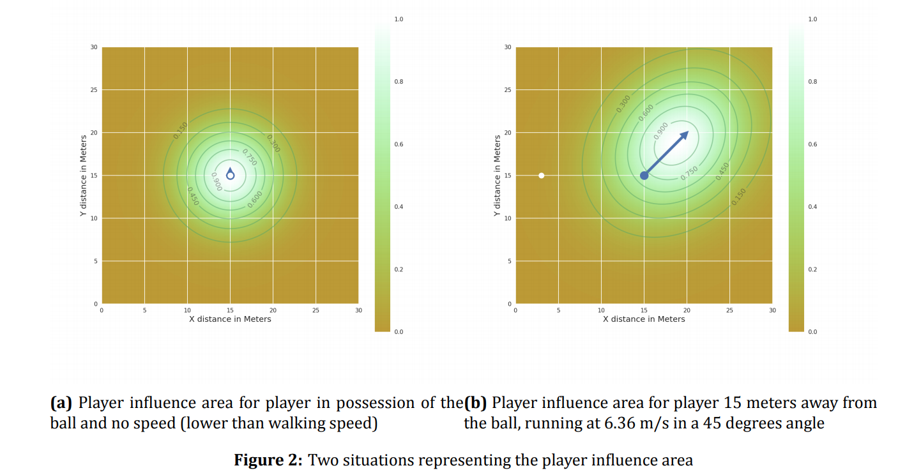
Field Control - Stationary
(Fernandez & Bornn, 2018)
Notes:
No speed

Slide 38
Field Control - On the Move
(Fernandez & Bornn, 2018)

Slide 39
Field Control
(Fernandez & Bornn, 2018)

Slide 40
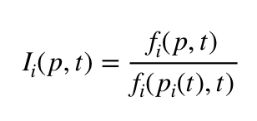
Field Control
We take this “control” we’ve calculated for each player on the field and compute the team “control”
An probability density control at a point p on the field is the normalization of a player’s bivariate distribution, f
The sum of players control for each point gives us team control of the field

Slide 41
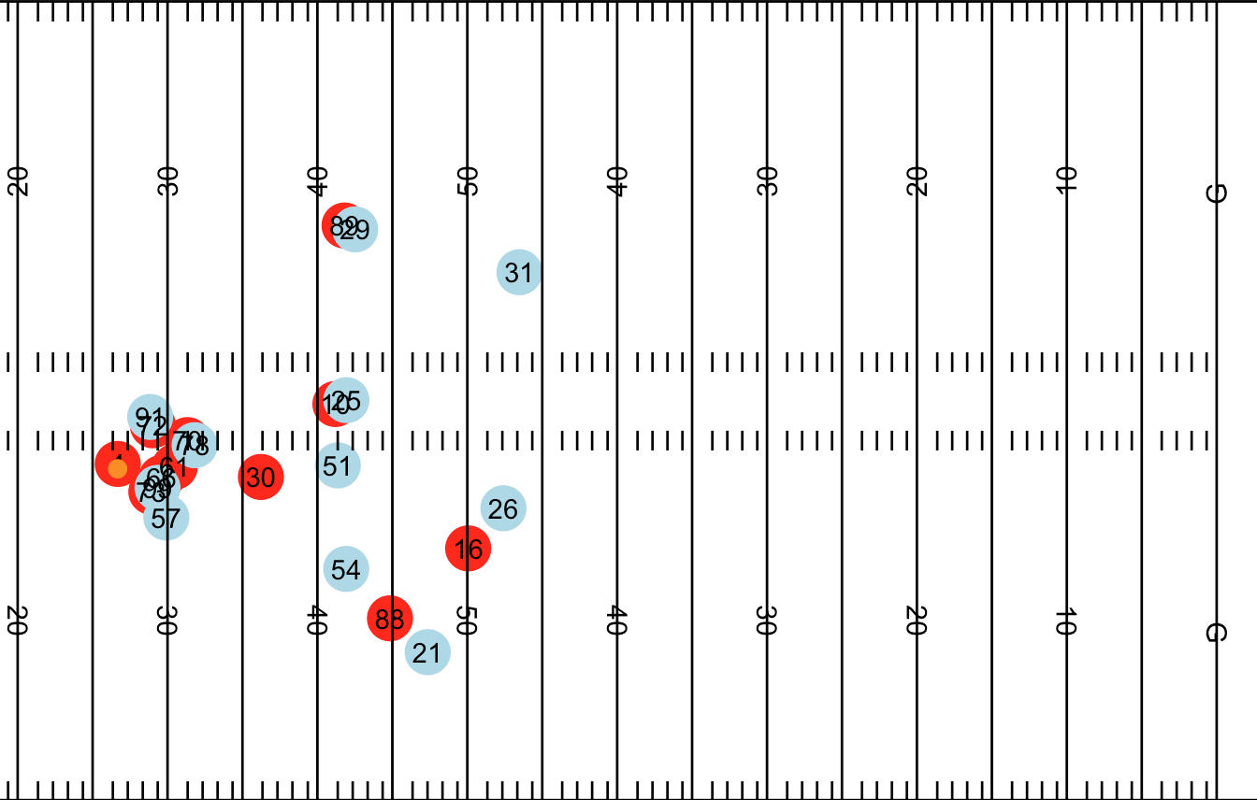
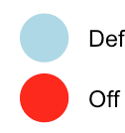
The Out and Go - Openness
Notes:
Matt:
Introduce the plots a bit as the audience may not be familiar with this,
what are the dots,
what does the color represent,
What is the scenario here, ball snap? time of throw?

Slide 42
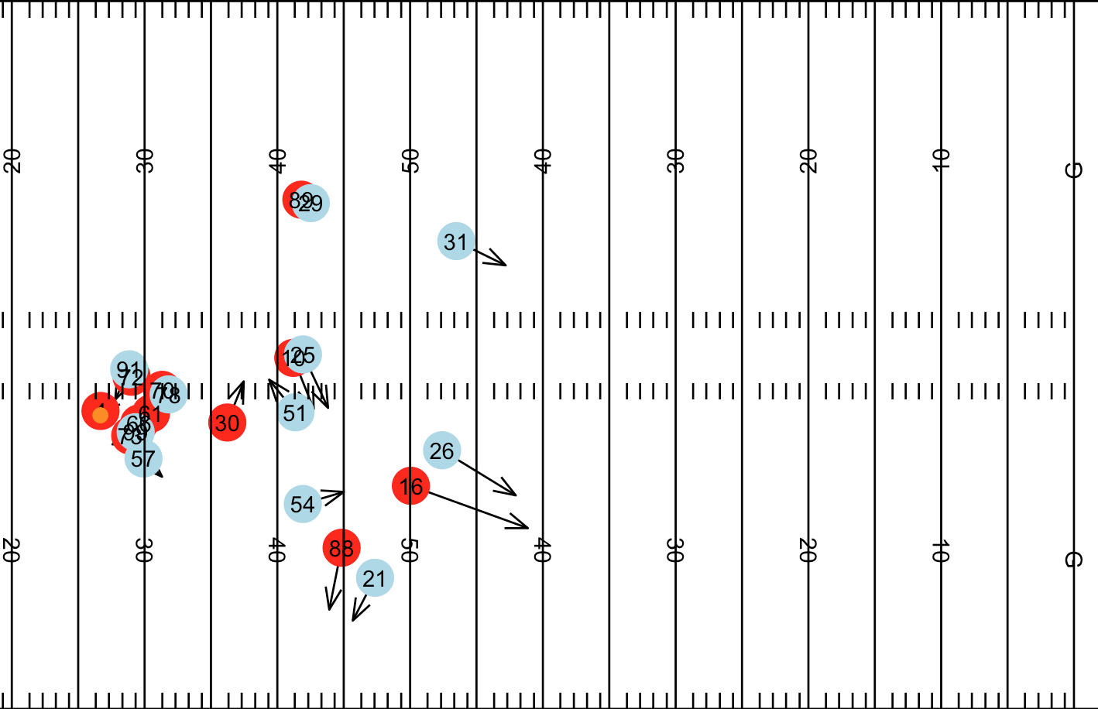
The Out and Go - Openness
Notes:
Matt:
Add the scale of color
Introduce the plots a bit as the audience may not be familiar with this, eg what are the dots, what does the color represent, what does the arrow represents
Tttle: What we propose??

Slide 43
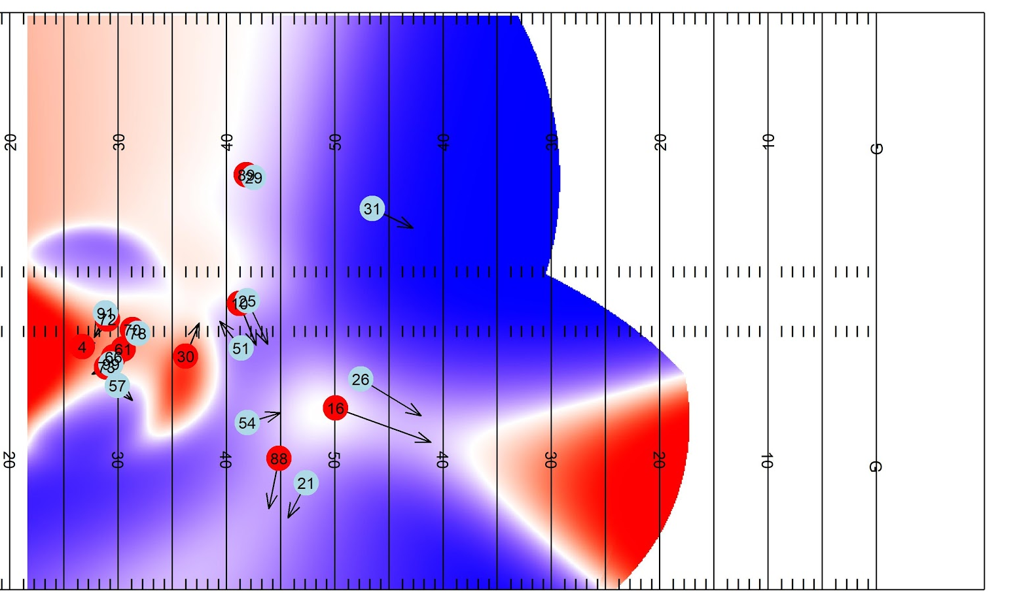

The Out and Go - Openness
Offense
Neutral
Defense
Notes:
Matt:
Add the scale of color
Introduce the plots a bit as the audience may not be familiar with this, eg what are the dots, what does the color represent, what does the arrow represents
Tttle: What we propose??
Ball openness, not control?
Is openness good at the moment or is openness good at a 1sec later?

Slide 44
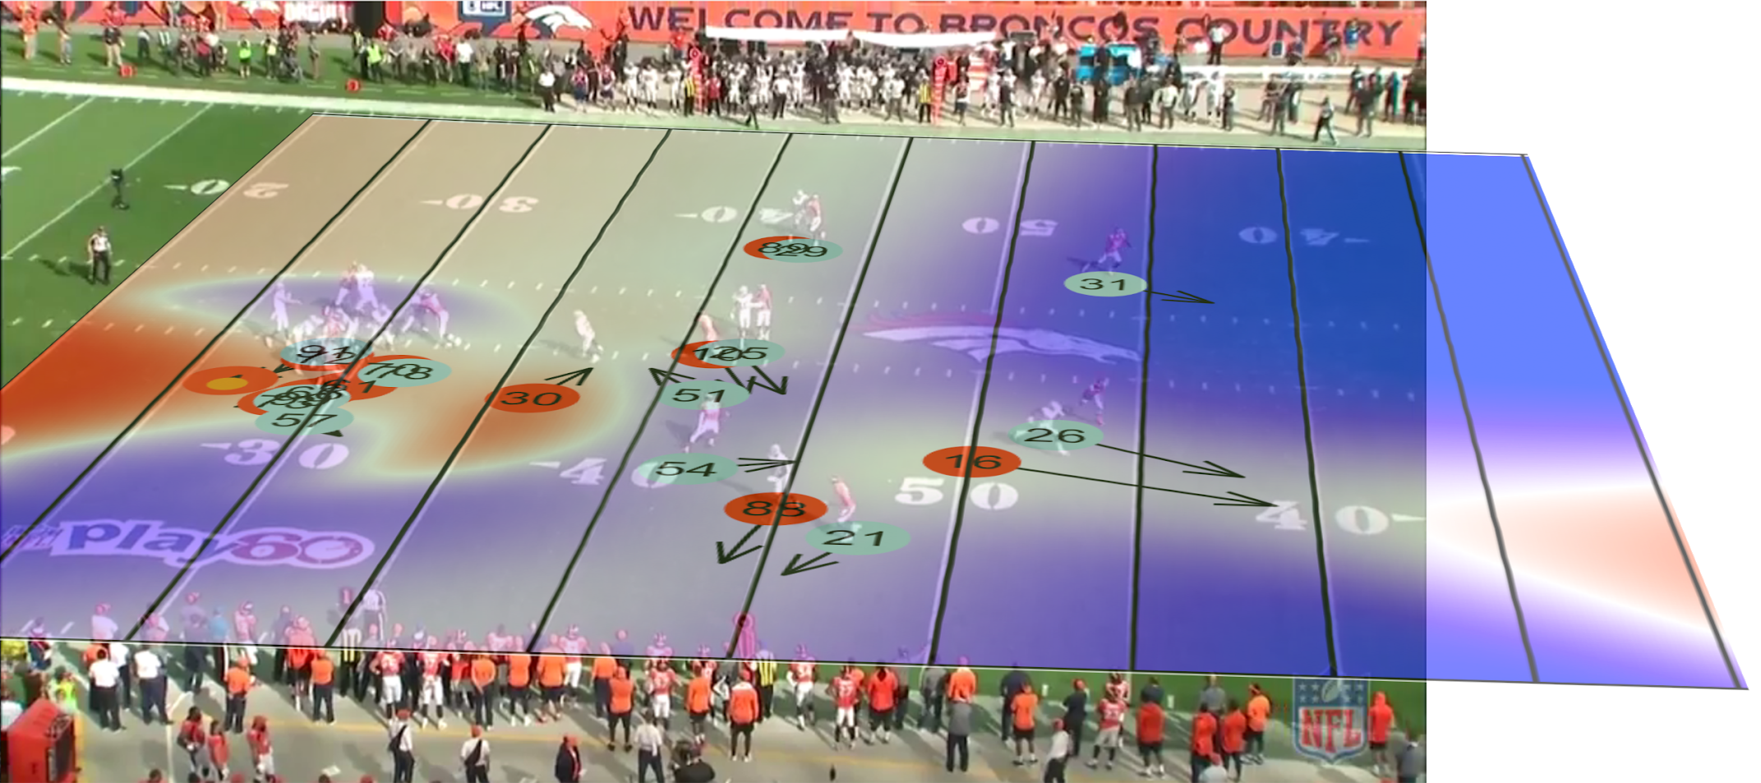
The Out and Go - Openness
Offense
Neutral
Defense
Notes:
Matt:
Add the scale of color
Introduce the plots a bit as the audience may not be familiar with this, eg what are the dots, what does the color represent, what does the arrow represents
Tttle: What we propose??
Ball openness, not control?
Is openness good at the moment or is openness good at a 1sec later?

Slide 45
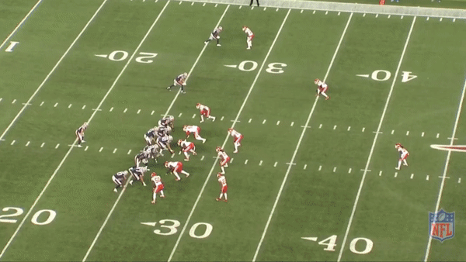
Incomplete - Openness
Offense
Neutral
Defense
Notes:
Matt:
Add the scale of color
Introduce the plots a bit as the audience may not be familiar with this, eg what are the dots, what does the color represent, what does the arrow represents
Tttle: What we propose??
Ball openness, not control?
Is openness good at the moment or is openness good at a 1sec later?

Slide 46
Play Database
Notes:
Matt:

Slide 47
Play Database
Can identify play description, results and other information based on:
Team
Players
Routes Run
Location
For example we can pull film for:
Out route and a Go route
Michael Thomas and Alvin Kamara lined up on the same side of the field
DeAndre Hopkins running a comeback
Notes:
Matt:

Slide 48
Actionable Results
Player route profiles
Monitor player tendencies, usage and effectiveness
Play evaluation metrics
Evaluate the play book
Play database
Identify plays of interest
Pull film quickly
Save 1000s of hours tagging film
Notes:
Matt

Slide 49
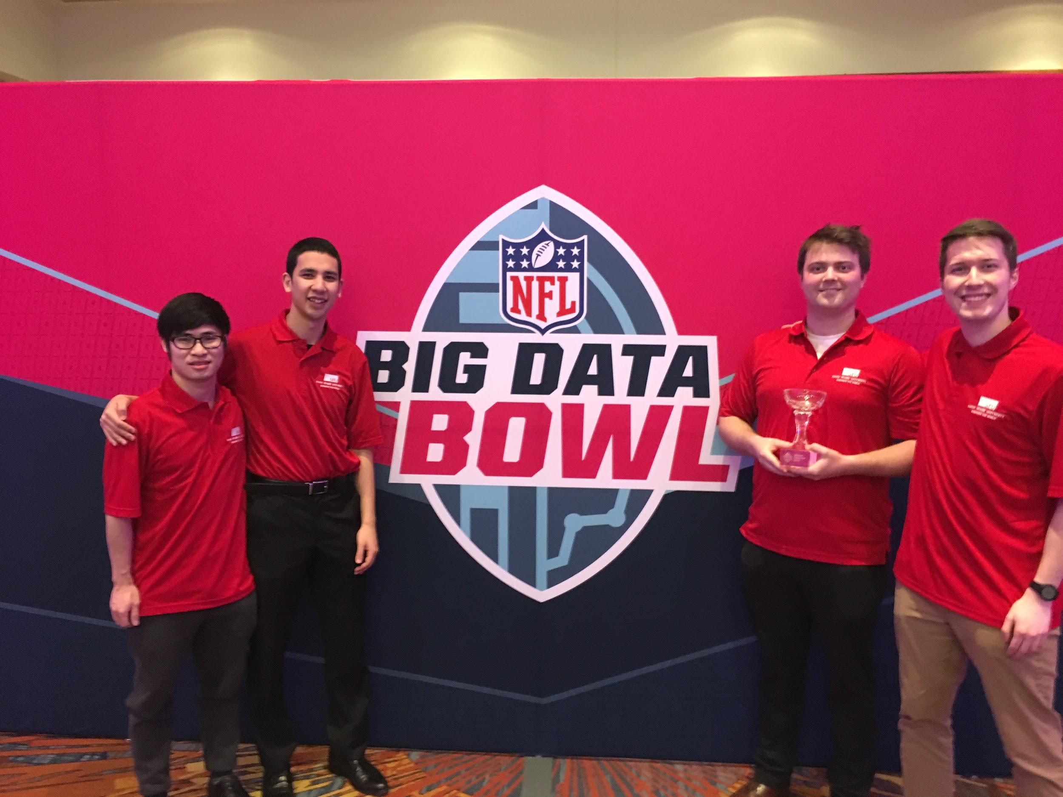
Other Results!

Slide 50
Thank You!
Any Questions?
Dani Chu
dani_chu@sfu.ca
@chuurveg
Matthew Reyers
matthew_reyers@sfu.ca
Email:
Twitter:
James Thomson
james_thomson_2@sfu.ca
Lucas Wu
yifan_wu@sfu.ca
Email:
Notes:
Matt:

Slide 51
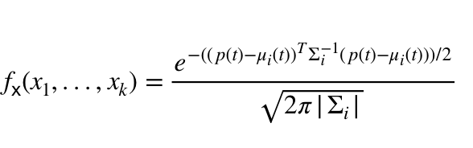
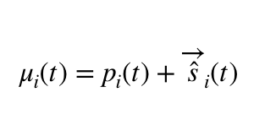
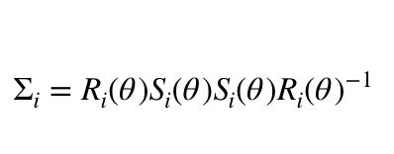
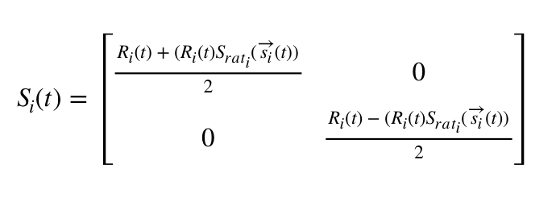
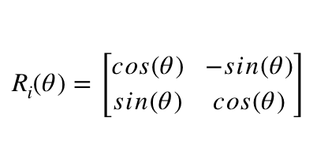
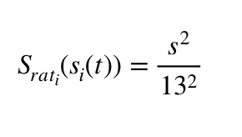
Calculating Player Control
We estimated player control with a bivariate normal distribution
Notes:
For the kth player at time I we compute a bivariate normal taking into account the velocity of the player, and project it one second ahead of them.

Slide 52
What we remember
Notes:
This might be a way of transitioning to result-based vs process-based
Stolen idea from Michael Lopez’s slide at https://statsbylopez.github.io/NESSIS2017_files/NESSIS_2017.html#how-often-does-the-best-team-win

Slide 53
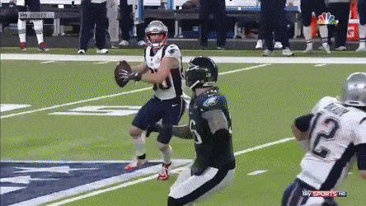
What we forget
Notes:
An example demonstrated a unsuccessful good play
Stolen idea from Michael Lopez’s slide at https://statsbylopez.github.io/NESSIS2017_files/NESSIS_2017.html#how-often-does-the-best-team-win

Slide 54
Process-based Play Evaluation
Top 5 Play Designs for Field Ownership (min 20 observations)
Rank | Play Design | Mean Ownership | SD of Ownership
1 | 2 Out, 1 In, 2 Flat | 0.35 | 0.11
2 | 4 Go, 1 Block | 0.34 | 0.09
3 | 2 Go, 2 Out, 1 Block | 0.32 | 0.06
4 | 2 Go, 2 Out, 1 Flat | 0.32 | 0.07
5 | 2 Go, 1 Out, 1 In, 1 Flat | 0.31 | 0.09
... | … | ... | ...
45/45 | 3 In, 1 Flat, 1 Block | 0.22 | 0.05
Notes:
Useful results, concern is that these are not the results of interest
Rebuttal: We have not assigned value to spaces on field yet, future work section valid

Slide 55
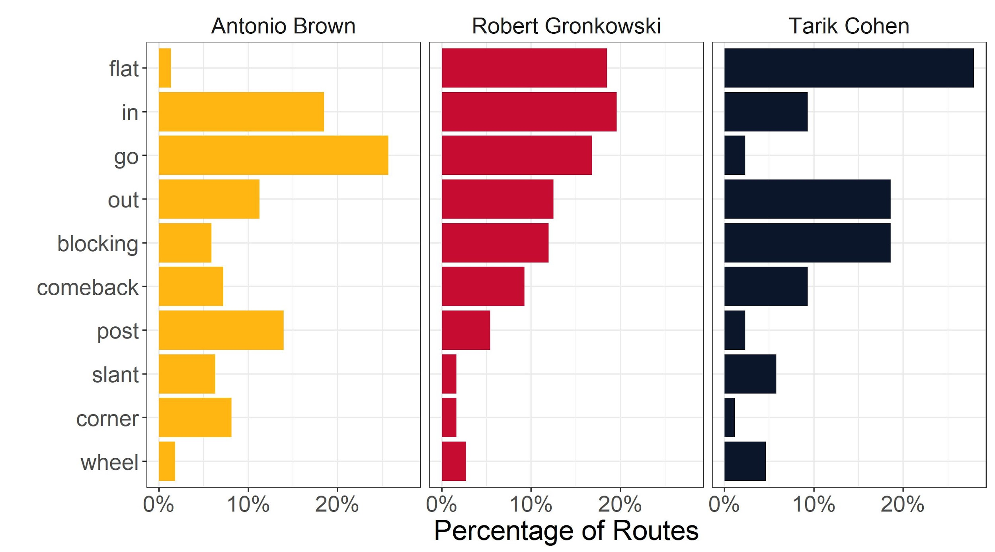
Route Profiles (WR, TE, RB)
Notes:
I’m thinking this moves to the poster

Slide 56
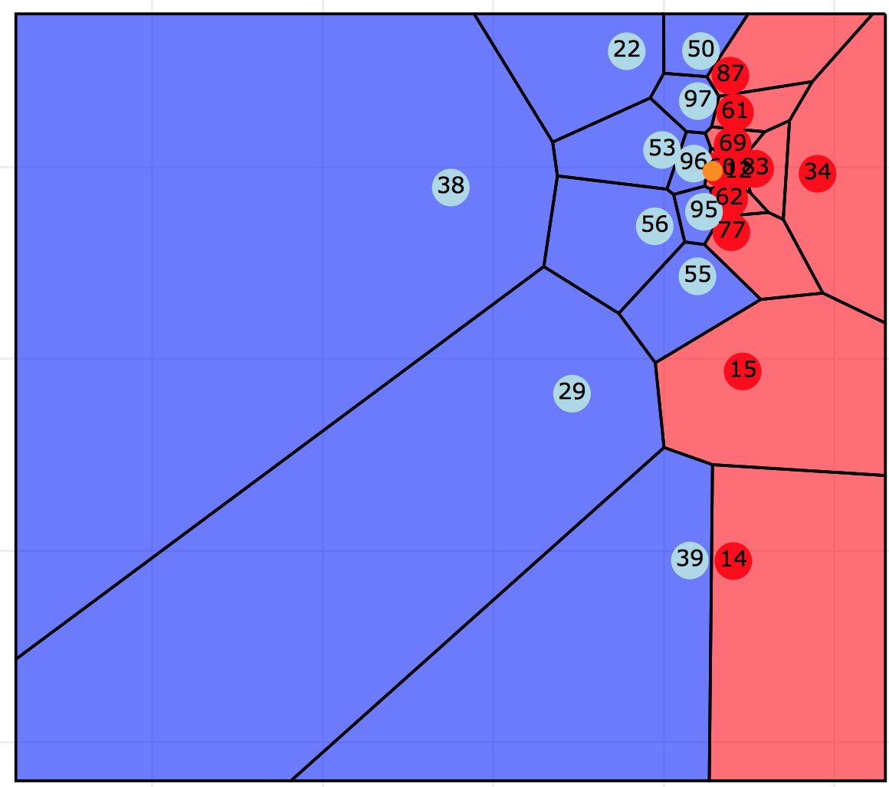
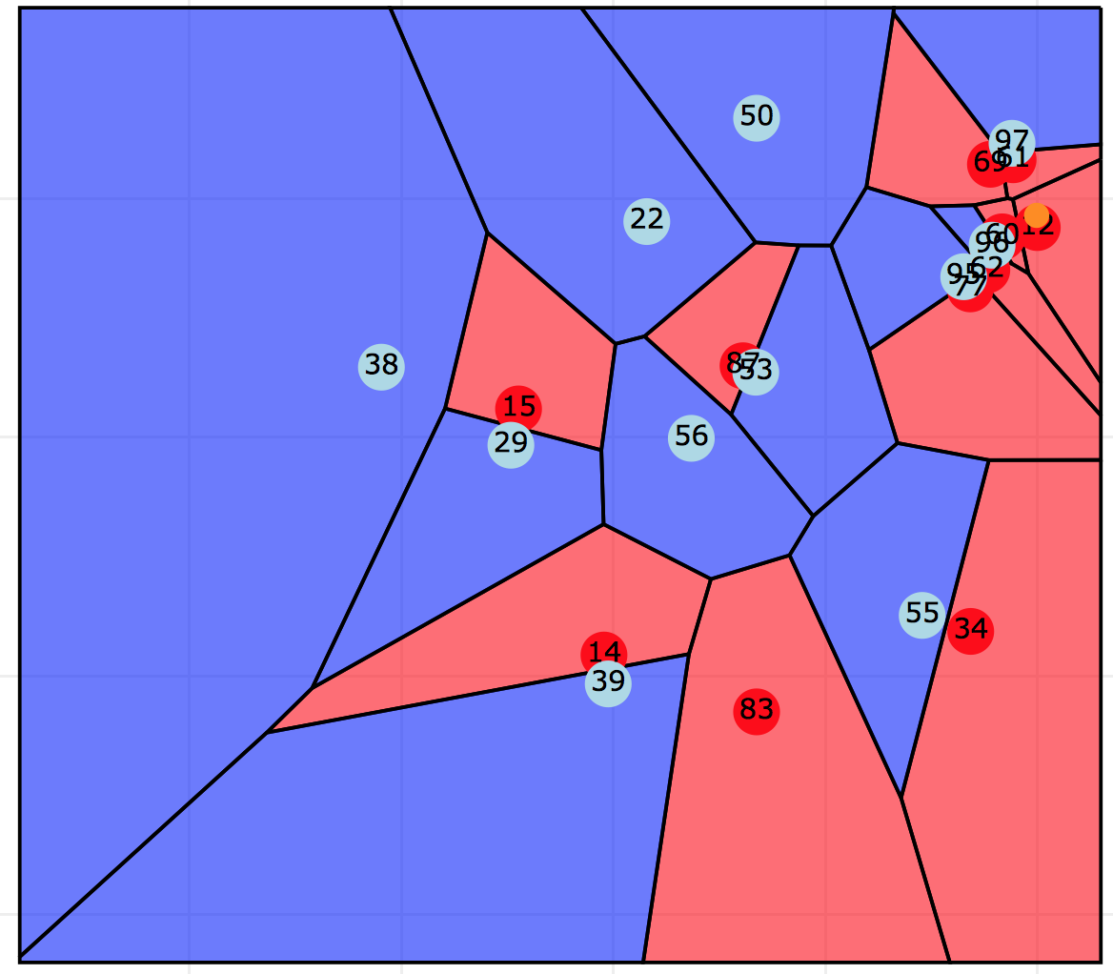
Can we Quantify Openness?
Notes:
Maybe show another example of a successful pass?
Can we change the title of each plot?
Highlight what Voronoi plots are and what they ignore (speed, dir) and what that causes (overestimation of controlled space)

Slide 57
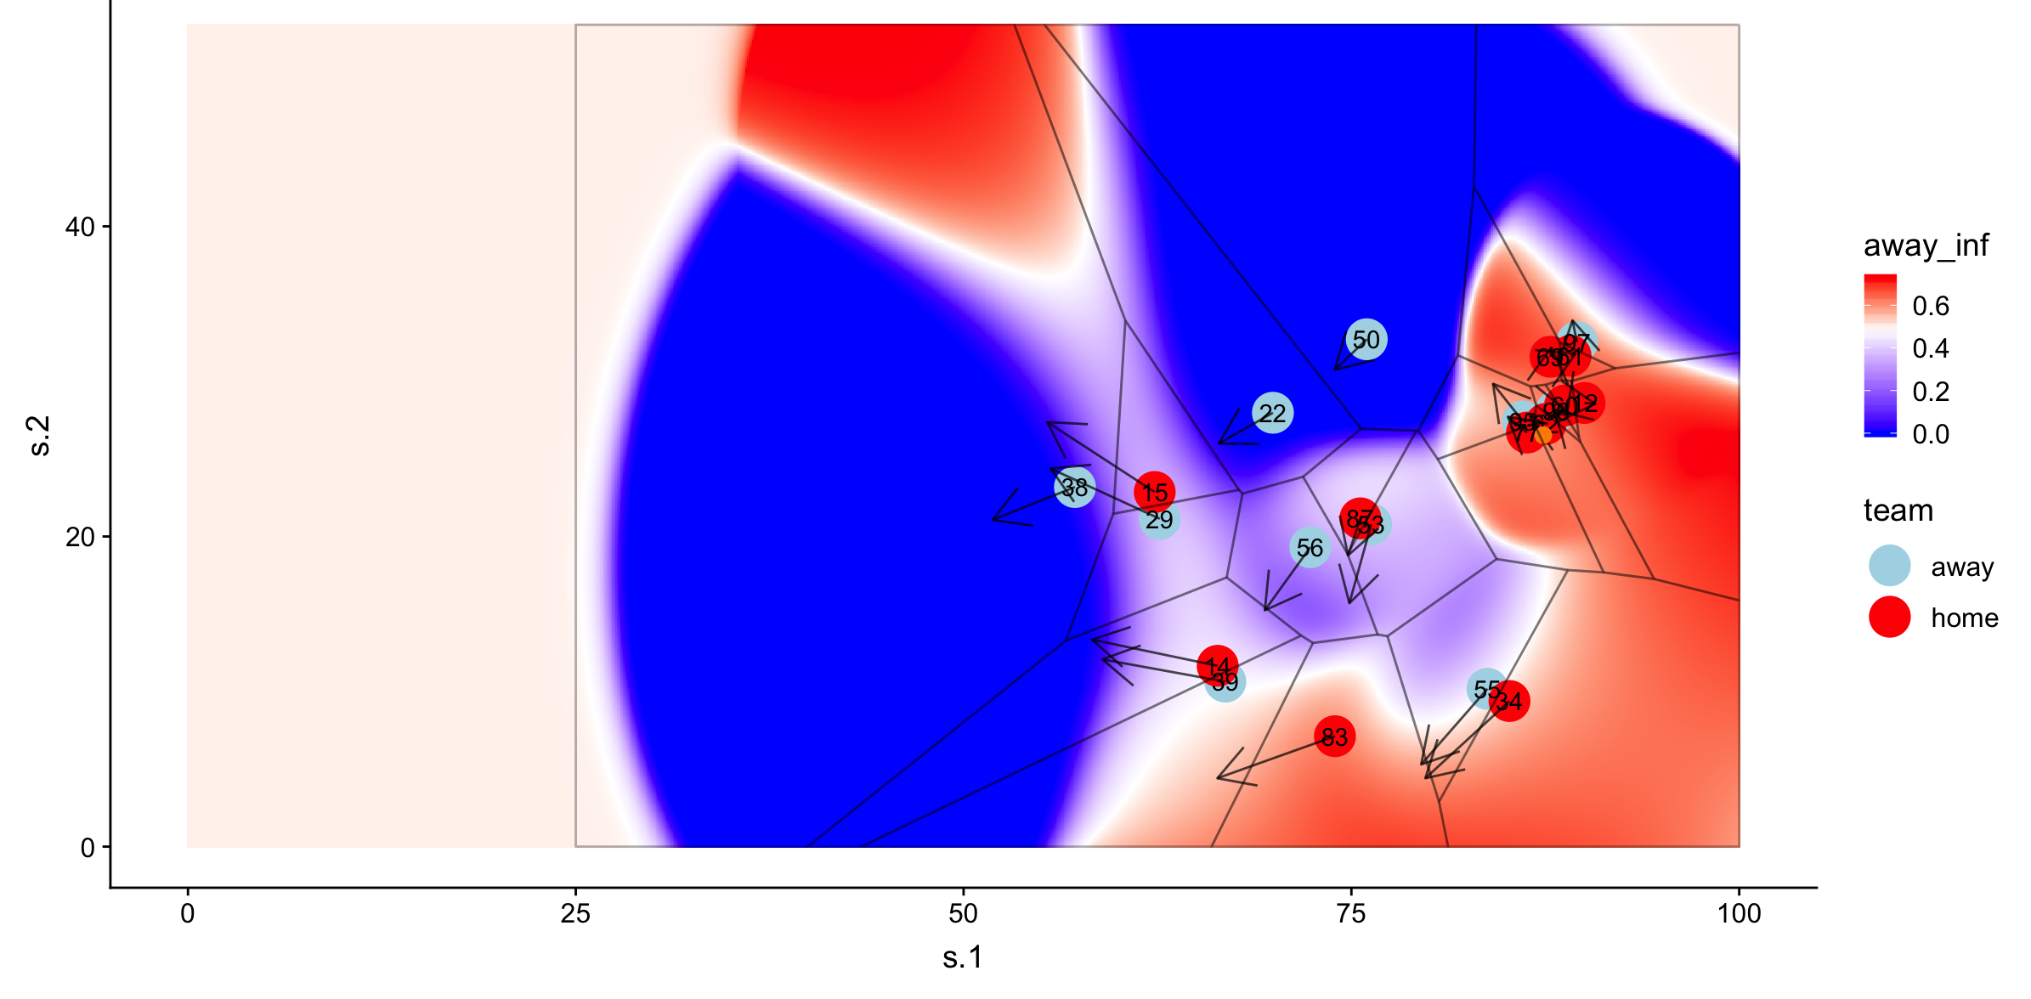
Comparison of Models
Notes:
Maybe we don’t need to show the comparison, put it here for our reference

Slide 58
What is Expected Points Added (EPA)?
Created by Carnegie Mellon Researchers Ron Yurko, Sam Ventura, Maxim Horowitz
Method for evaluating plays
5 yards are valued more on 2nd and 4 then 3rd and 8
Takes into account down, distance, time on clock, timeouts remaining, etc.
Does not take into account: team strengths, play/drive sequencing
Play can be measured as
Successful or Unsuccessful
Or by an actual value

Slide 59
Evaluating Route Combinations
Accounting for Defensive Packages, Men in Box, Pass Rushers
Model a Route Combinations effect on Success Rate and EPA

